Slide 1


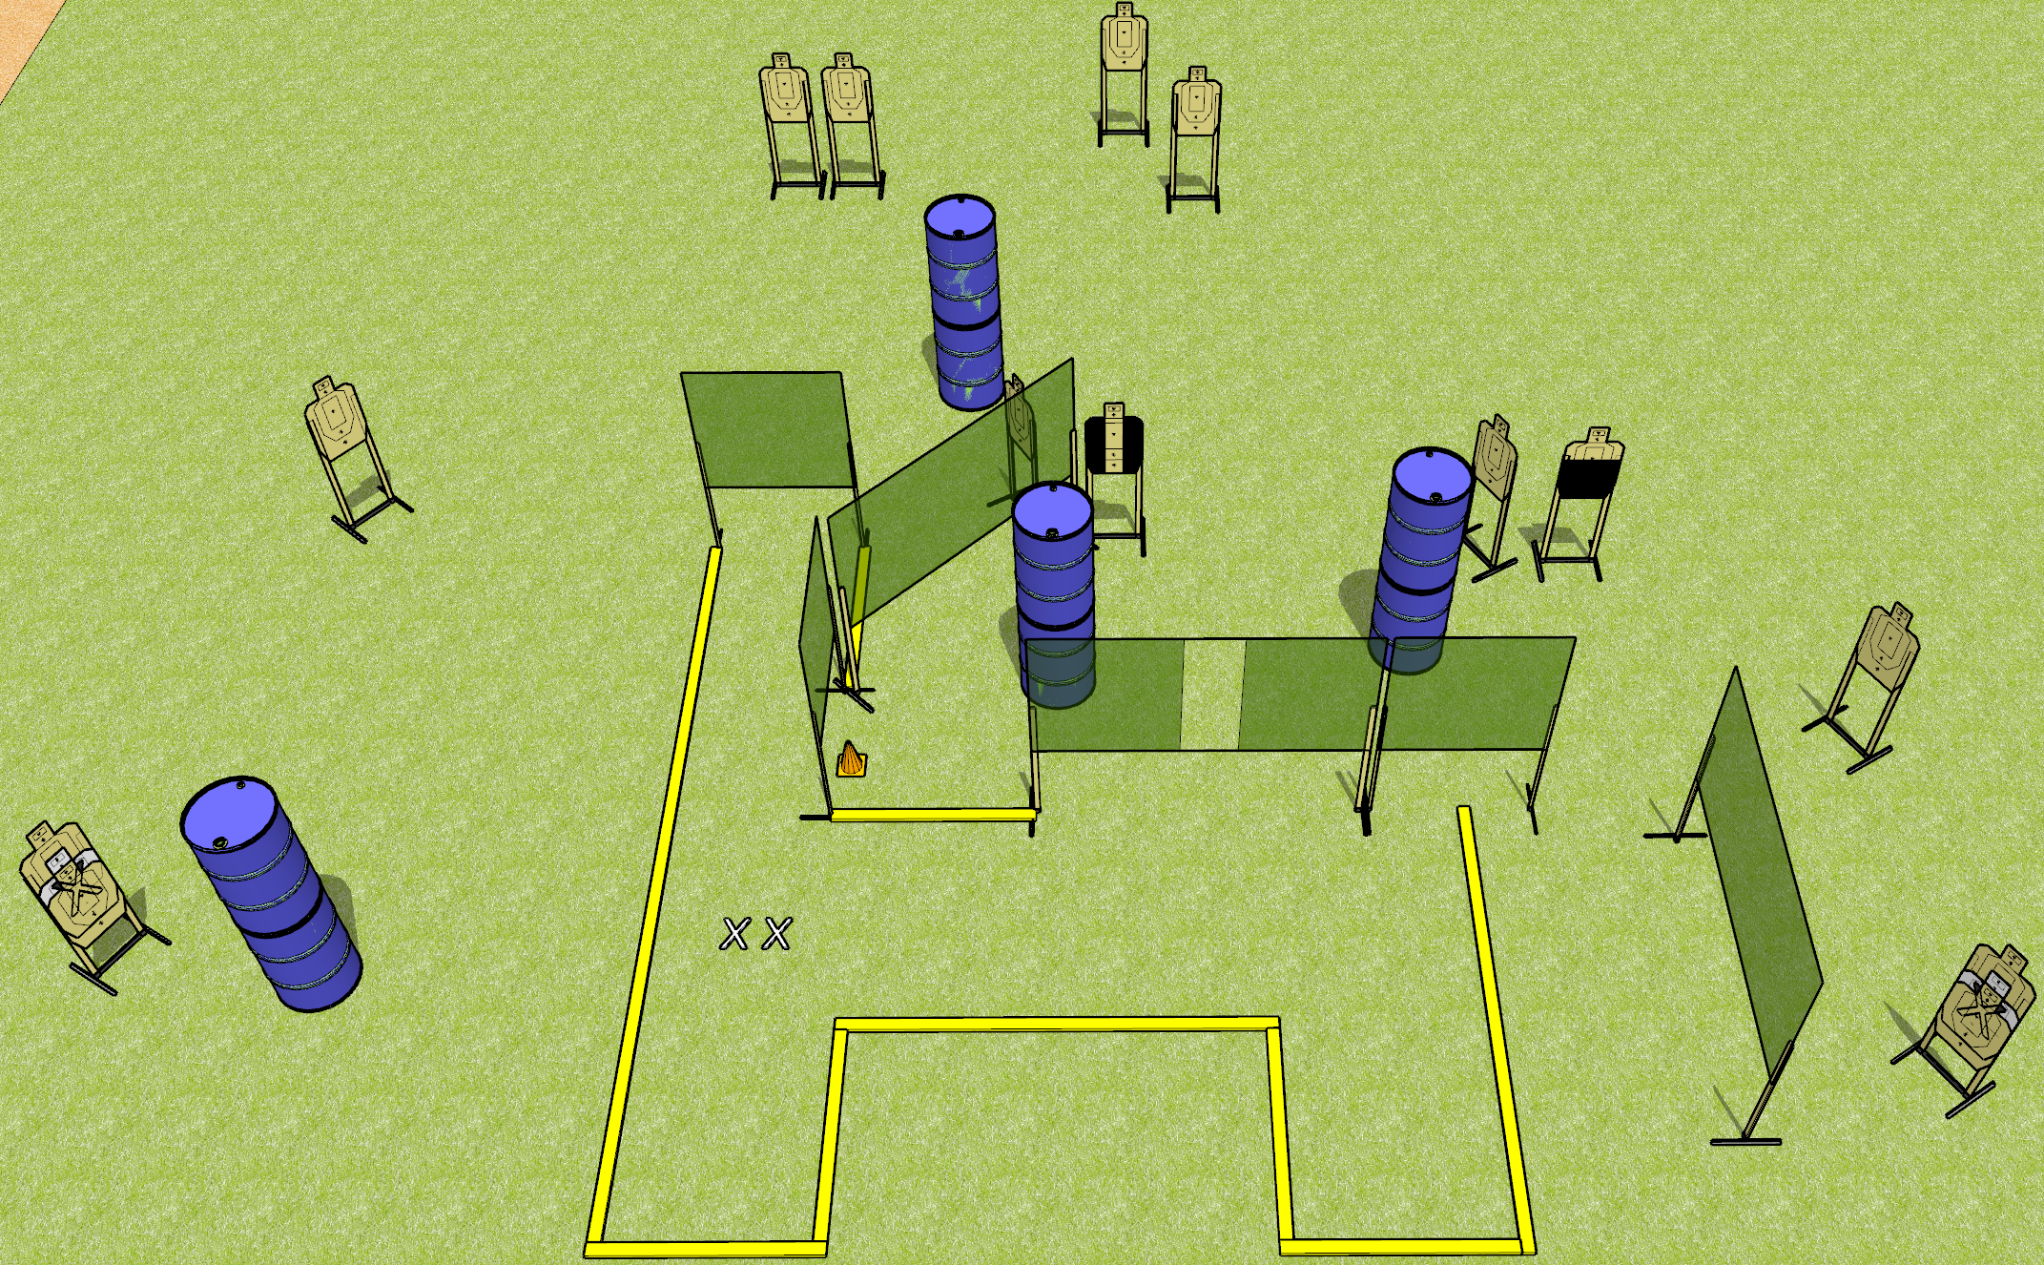
 | Dothan Gun Club – USPSA Match Baby Huey Plus Course Designer : Patrick Free
START POSITION : Standing with both feet on X’s, wrists below belt
GUN READY CONDITION : Pistol loaded and holstered. PCC loaded, held with both hands, shouldered, safety on, pointed at orange cone. |  | SCORING: Comstock, 28 rounds TARGETS: 14 paper, 0 Steel SCORED HITS: Best 2 on paper, steel until down START-STOP: Audible, last shot RULES:
STAGE PROCEDURE: Engage targets as they become available from within the fault lines.

Slide 2
Baby Huey Plus
Written Stage Briefing
Baby Huey Plus is a 28 round, 140 point, Comstock field course. There are fourteen USPSA targets. The best two hits on paper will score. The start signal is audible.
Handgun start position is both feet on X’s, wrists below belt. Handgun is loaded and holstered.
PCC start position is both feet on X’s, muzzle pointed at orange cone. Loaded carbine is held with both hands, safety on, shouldered.
On start signal, engage targets as they become available from within the shooting area.

